Slide 1
Visual C++ 2010
IDE Tutorial
Prepared by Daniel Lee, Li Mengran

Slide 2
Integrated Development Environment (IDE)
Why use an IDE?
Syntax highlighting
Built-in compiler
Rapid GUI development via drag-and-drop
Integrated debugging
Better management of source files
And many more…
Get Visual Studio 2010 from Microsoft Dream Spark
https://www.dreamspark.com/default.aspx

Slide 3
Contents
Part A - Step by step guide to the basic functionalities of the IDE with a “HelloWorld” program.
Part B - Introduction to Debugging
Part C - Introduction to GUI

Slide 4
Part A

Slide 5
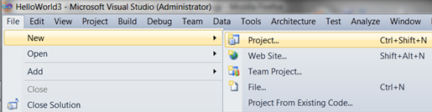
Creating a New Visual C++ Project
On the top menu bar, click:
File → New → Project.
Alternatively, use the keyboard shortcut Ctrl + Shift + N.
This will bring up the new project dialog box.

Slide 6
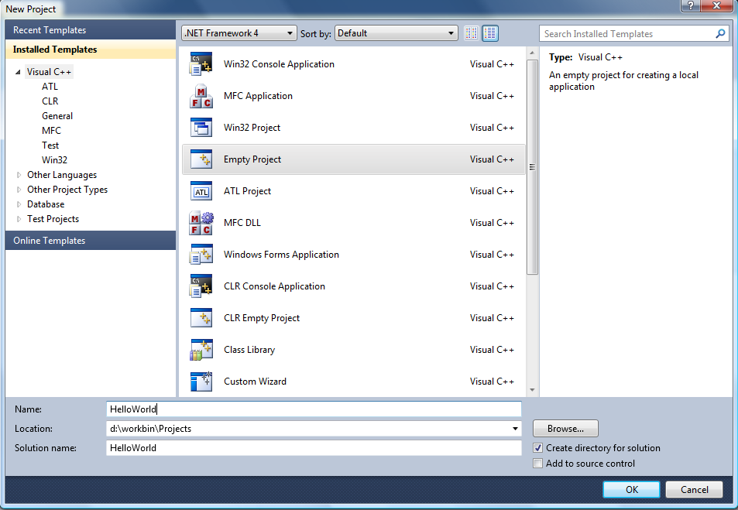
Creating a New Visual C++ Project
Depending on the preferences you set when installing Visual Studio, the options may vary. For the purpose of this tutorial, select Visual C++ in the left pane and Empty Project in the right pane.
Enter the name “HelloWorld” for your project, and the folder that the project files will be stored in.
Keep the other options as their default.

Slide 7
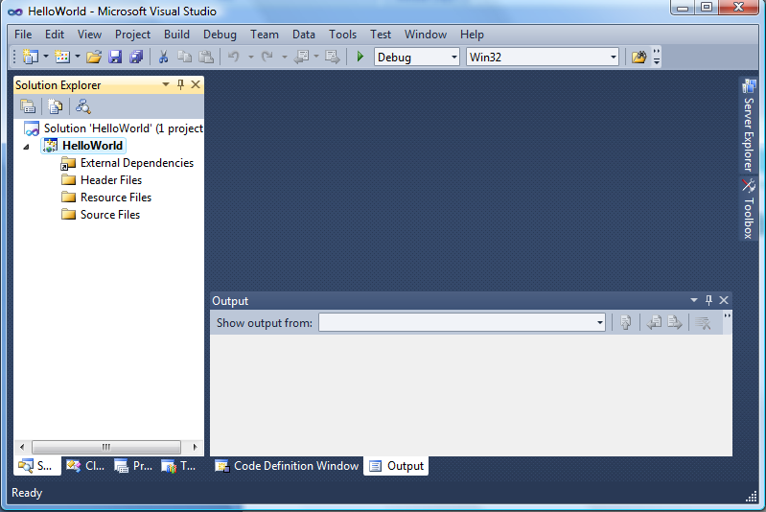
The Visual Studio Interface
The solution explorer pane displays the various files in your project in the form of a tree.
Click the triangular buttons to the left of the individual folders to expand or collapse them. (If a folder is empty, the expand/collapse button is not displayed)
This space is for editing opened files. We have no files opened yet, so it’s blank for now.
The output pane displays messages such as results and errors from compilation and execution of your program.
This will be explained in greater detail later.

Slide 8
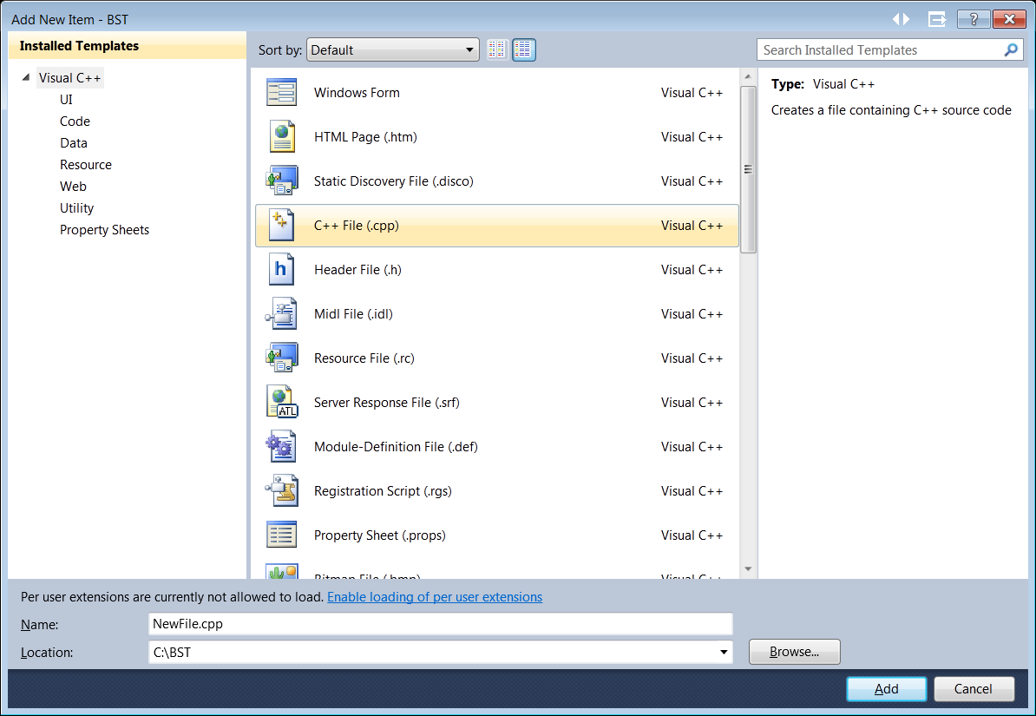
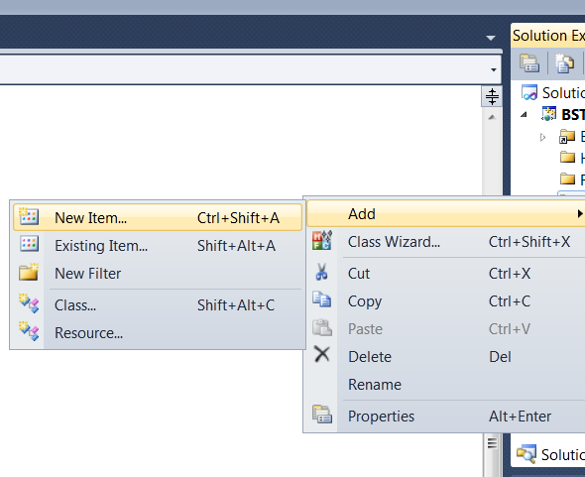
Now we add a new CPP source file
Right-click on the “Source Files” folder in the solution explorer. Select
Add → New Item.
In the Add New Item dialog box,
Select Visual C++, C++ File, and type a name for your file, say “HelloWorld”. (see the highlighted regions above).
This file will be named with a .cpp extension and you will find it in the “Source Files” directory in the Solution Explorer pane.

Slide 9
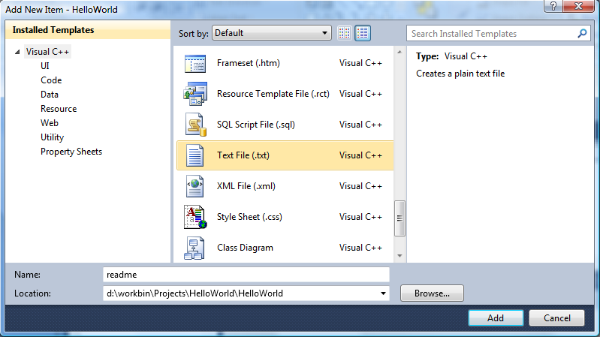
Add a text file just for kicks
Right-click on the “HelloWorld” folder in the solution explorer. Select
Add → New Item.
In the Add New Item dialog box,
Select Visual C++, Text File, and type “readme” for your file name. (see the highlighted regions above).
This file will be named with a .txt extension and you will find it in the “HelloWorld” directory in the Solution Explorer pane.

Slide 10
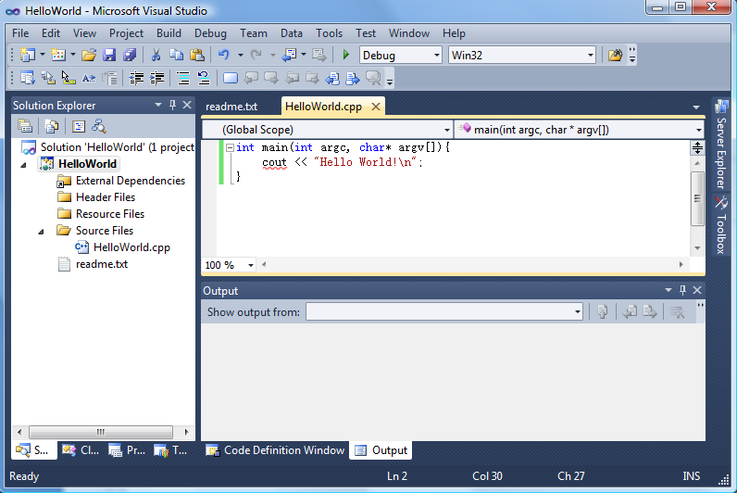
Type in the following codes into your “HelloWorld.cpp”
int main(int argc, char* argv[]){
cout << “Hello World!\n”;
}
VS allows you to work with multiple files concurrently. Click on the tab to switch to a file. The selected file has its name highlighted in the tab. Keyboard shortcut: Ctrl + TAB. Alternatively you could double click on a file in the solution explorer to select it.
Notice the word “cout” which has a red curly line below it. This means that it is undefined. This spells trouble, but we are going to let it be for the moment, so that we can see what the compiler has to say about this error.

Slide 11
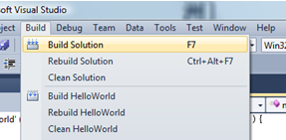
Compiling HelloWorld
Now let’s compile our program. Choose Build > Build Solution from the menu. Alternatively, use the F7 keyboard shortcut.

Slide 12
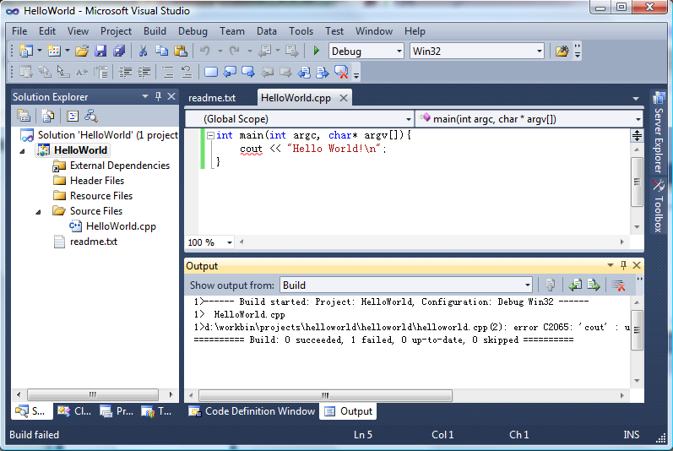
Handling Compilation Errors
Sure enough, the compilation fails.
Double-clicking on the error message takes us to the line where the error has occurred. In this case the message tells us that “cout” is an undeclared identifier.
Note that the error reporting mechanism is not perfect. We sometimes have to search the vicinity of the line reported in the message. In this particular case, the error reporting is accurate.

Slide 13
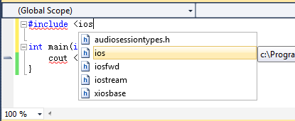
Intellisense/Autocompletion
Now we include the header for “cout”, to correct the compilation error.
Type the following line at the beginning of “HelloWorld.cpp”:
#include <iostream>
Notice that as you type, a window will popup, suggesting appropriate words you could type there. You can use up and down keys on the keyboard, or the mouse wheel to select one, and press enter to choose it. As you type more letters, the suggestion becomes more precise and the cursor will move to the entry that most closely matches what you’ve typed.
Microsoft calls this auto-completion functionality Intellisense. Its use is not just limited to the header files.

Slide 14
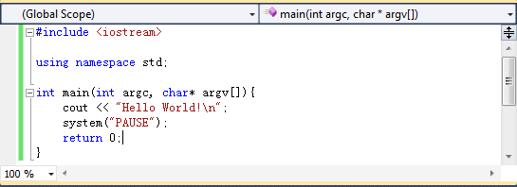
Completing HelloWorld
Type the following line between the header file inclusion and the start of function “main”:
using namespace std;
Then type the following lines after the “cout” statement:
system(“PAUSE”);
return 0;
The first of these two statements basically pauses the program at the end of execution, waiting for any key stroke to exit the program. Now our “HelloWorld” program is complete. Now build it again. You shouldn’t encounter any problem.

Slide 15
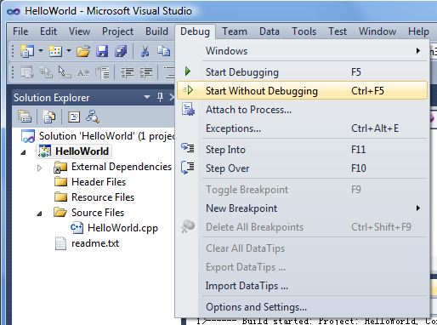
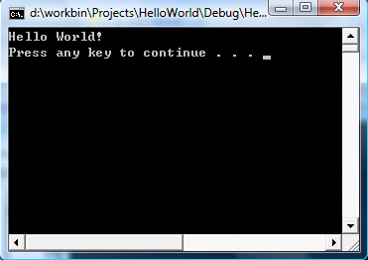
Running HelloWorld
Now let’s run our program. Go to Debug > Start Without Debugging (or Start Debugging). Keyboard shortcuts: Ctrl+F5 or F5. Debugging will be discussed next.
A console will pop up facilitating input and output of the program. Output will be displayed here for our simple console program, you can also type input here if you have input statements like “cin” in your program. For our “HelloWorld”, it just prints a friendly message and prompts for a key stroke to terminate.

Slide 16
Part B

Slide 17
Debugging with our trusty ally -- debugger
Step through the program while inspecting its state
Three kinds of stepping (in pause mode):
“Step into” executes one statement; if that statement is a function call, it proceeds with the call and pauses at the first statement in the function.
“Step over” is similar to “step into”, except that if the statement is a function call, it executes the function in its entirety and pauses immediately after the function returns.
“Step out” executes until the current function returns and pauses.

Slide 18
Diagnosis of Buggy Sort
Reuse our “HelloWorld” project
Replace the contents of our “HelloWorld.cpp” with those in “BuggySort.cpp” which comes with this handout.
It should print an array of 16 numbers, sorts them by bubble sort, then prints the sorted array.
It is necessarily buggy. ☺
Build the “HelloWorld” project.
Now start executing with “Start Debugging”.

Slide 19
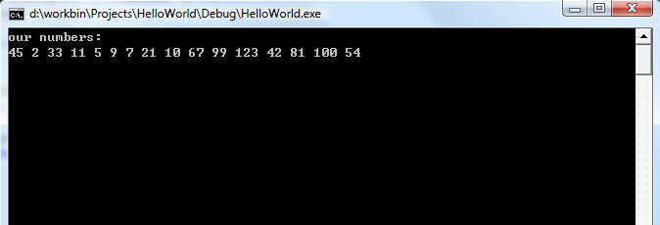
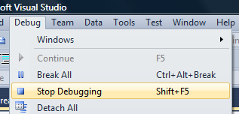
Program hangs!
A console will pop up. After printing the initial array, it hangs. So yeah, that confirms the program’s buggy. We need to step through the program to see what’s wrong. In order to do that, we need to execute in “break” mode. So first of all stop the program by going back to the IDE window and press “Debug →Stop Debugging”.

Slide 20
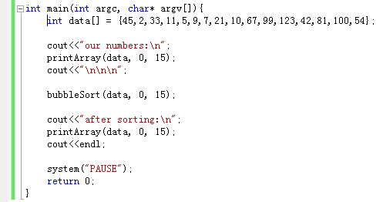
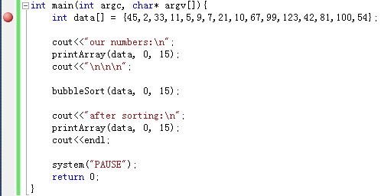
Breakpoints
The program runs until it encounters a break point, where it pauses and goes into “break mode”. Normally we would set the breakpoints at positions near the suspected error. Now suppose we don’t know any better, we just set one breakpoint at the beginning of the function “main”. Click the first line of “main” to bring the cursor there and then press the button “F9”.
Notice the red circle besides the line. It indicates that we have successfully set a breakpoint there. To remove this breakpoint, we just have to press “F9” again.

Slide 21
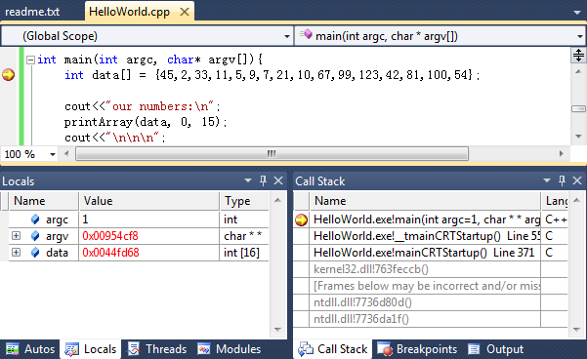
Program State
Run the program by choosing “start debugging”, and it will pause at the breakpoint we just set. Notice the little yellow arrow; it points at the next statement to be executed.
In the “Locals” pane, we can observe all the variables that are currently in scope. We can click on the “+/-” buttons besides structures, arrays and pointers to expand them, which will be discussed on the next page.
We can observe the execution trace through the call stack. Here it shows that “mainCRTStartup” at line 371 called “_tmainCRTStartup” which in turns at line 555 called “main”.

Slide 22
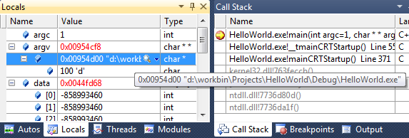
Structured Information For Variables
The value of a pointer is printed in hexadecimal format.
When we expand a pointer, the value at the position it points to is printed.
This pointer shown here points to a string “d:\workbin\...”. Therefore the value at the pointer position is the character ‘d’.
Hovering mouse over a pointer prints detailed information about it. In this case, it’s a “char*”, so the IDE prints the string stored in it.
Expanding an array prints all its elements. Now the assignments on the array “data” have not been executed yet. That’s why you see uninitialized values for all of them.

Slide 23
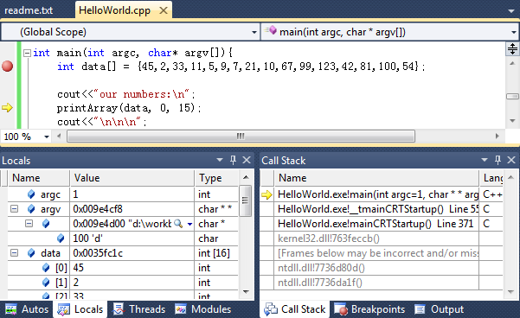
Stepping
Press “F10” twice to step over two statements. Now notice that the yellow arrow has advanced two statements to indicate our progress through the program. Now press “F11” to step into the function “printArray”, which simply prints the contents of an array passed in as the first parameter.
Notice the values of the array have been set.

Slide 24
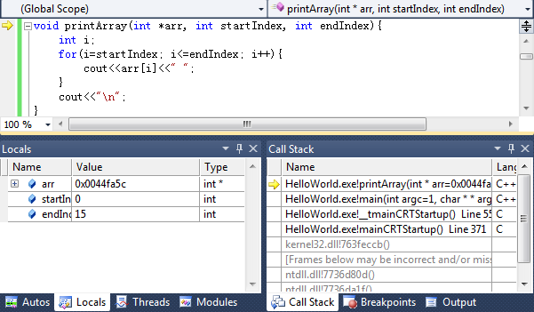
Notice that the program paused at the entry of the function.
Note that we are not restricted to viewing the information about this function only. We can inspect any function on the stack by double clicking it in the call stack frame. Now double click on function “main”.
Notice that the call stack reflects the program trace; a new frame, for the function “printArray” has been stacked on top.

Slide 25
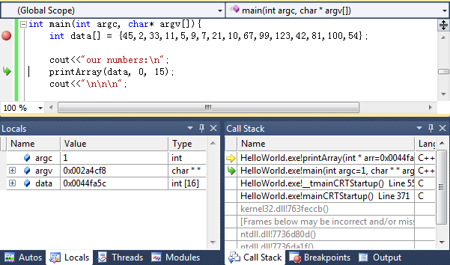
The green arrow here points to the statement which gets executed after returning from the function “printArray”.
Notice the green arrow pointing to the function we are currently inspecting.

Slide 26
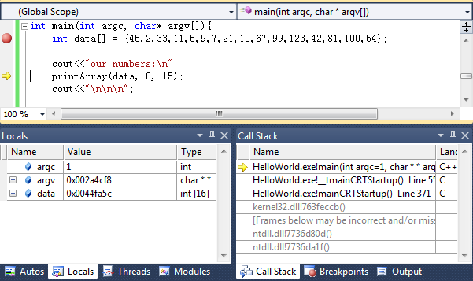
Stepping Out
But we realize that the function “printArray” is not likely to be the culprit, since the array did get printed before the program hangs. So we don’t want to waste time stepping through it. Now let’s press “Shift+F11” to step out of “printArray”. This will finish executing it, and pauses immediately after returning, as shown below. Do not be surprised that the yellow arrow points to the “printArray” statement, as there is some wrapping up to do after returning. Now press “F10” twice and “F11” once to enter the function “bubbleSort”.

Slide 27
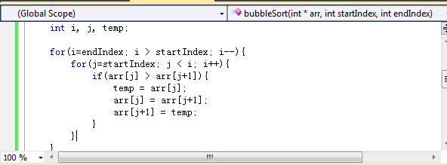
Running To Cursor
Now since we have a hanging program problem. Most likely it is due to infinite loops. We want to examine the exit points of the loops without having to step through all the statements.
Click on the closing “}” for the inner loop to move the cursor there, then press “CTRL+F10” to run to cursor.

Slide 28
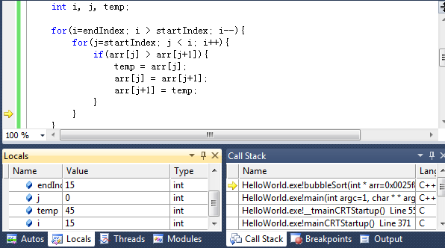
Checking Indices
Observe the values of “i” and “j” just before the first iteration of the inner loop is finished. There’s nothing wrong with them. So press “F10” twice to step over the closing “}” and the stepping statement of the inner loop.

Slide 29
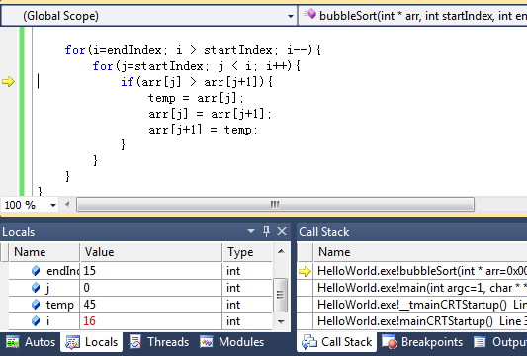
Checking Indices (continued)
Observe that the value of “i” has changed from 15 to 16, which is highlighted by the red colour, while the value of “j” remains unchanged. We’d actually like “j” to increment by 1 instead of “i”. This error prompts us to look closely at the stepping statement of the inner loop. There we find that we should have typed “j++” instead of “i++”. Now stop debugging by pressing “Shift+F5” and then change “i++” to “j++”.

Slide 30
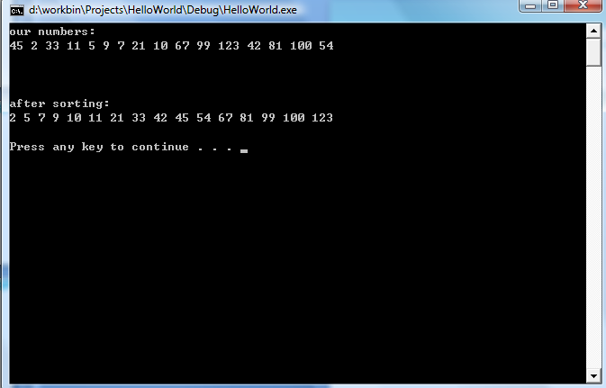
Bug Free Now
Now recompile, and try executing with “start without debugging”. You should see the program behave as we want now. ☺

Slide 31
Part C

Slide 32
GUI Two Aspects
Hierarchical Structure of Containers And Components
Toplevel Container
Appearance
Sub Container
…….
Sub Container
Component
……
Component
……
Component
Event Handlers
Behaviour
button_click,
mouse_click,
window_resize,
Etc…

Slide 33
Two Approaches for VC++
Microsoft Foundation Class (MFC)
.Net Common Language Runtime Compilation (CLR)
We introduce the latter since it is much easier to pick up and use
We start with a simple example

Slide 34
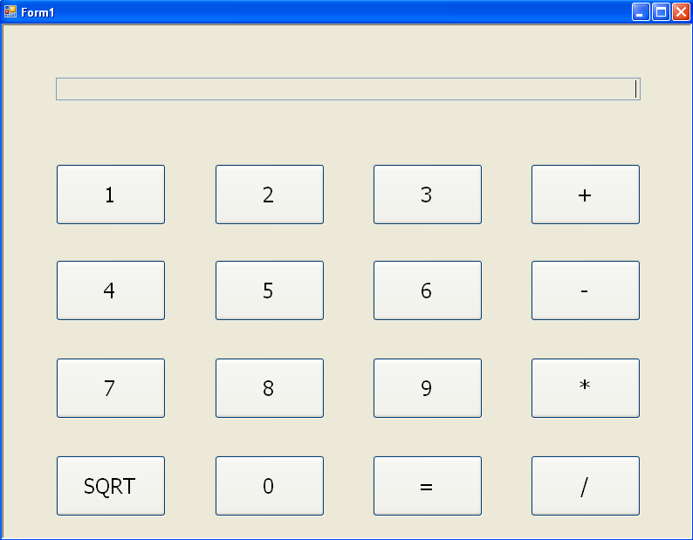
Our Goal, the Appearance Aspect
Containers hold components together logically and graphically
This entire form is the toplevel container.
Textbox component
Components are functional parts for input and output
Button Components

Slide 35
Our Goal, the Behaviour Aspect
A simple calculator, duh…
Now time to do it already

Slide 36
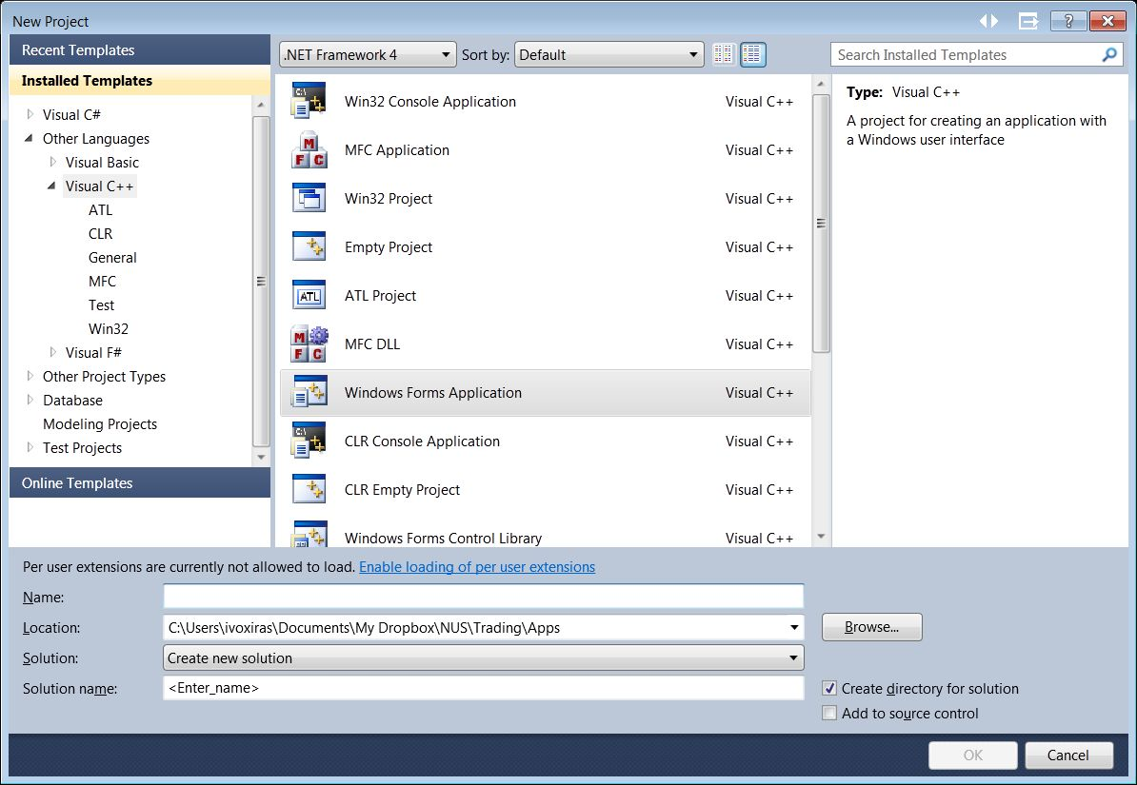
Creating a new GUI project
The process is similar to the earlier tutorial. This time, select Windows Forms Application instead.
Enter a project name, say “SimpleCalculator” and a folder to save the project in.

Slide 37
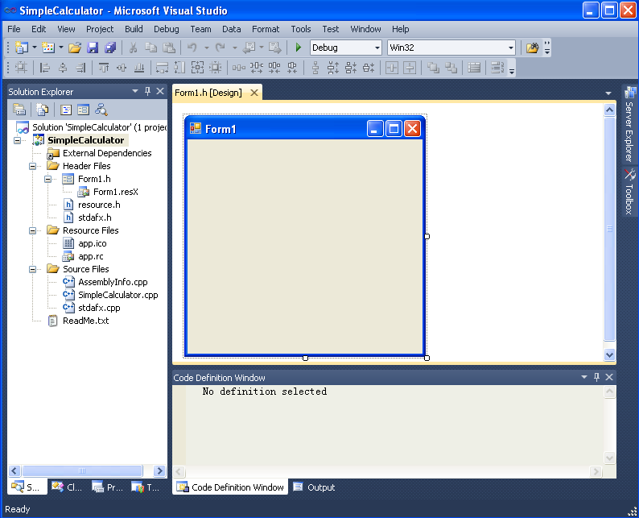
Skeleton given by IDE
The toplevel container, where we draw our components
Click on “Toolbox” to bring up a list of ready-made components for our selection
Our old friend Solution Explorer

Slide 38
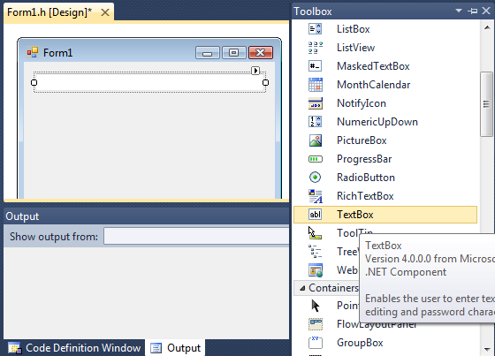
TextBox
Now drag and drop a TextBox component onto the form. You can resize it just as you resize any window. This would be our display panel.

Slide 39
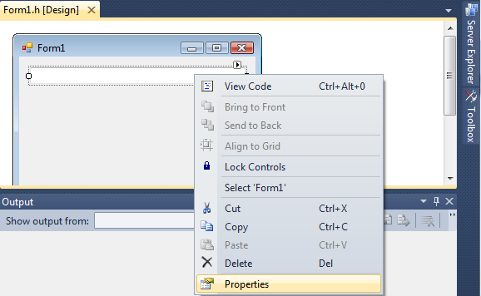
TextBox properties
Now right click on the TextBox we’ve just added, and select “Properties”.

Slide 40
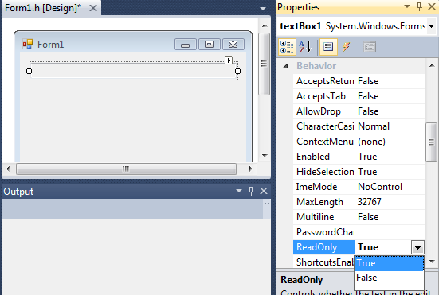
TextBox properties continued
In the properties pane, we can customize the components.
In the “Behavior” group, click on the property “ReadOnly”, and change its value to true by selecting it from the dropdown menu. Similarly, in the “Appearance” group, change the value of property “TextAlign” to “right”.

Slide 41
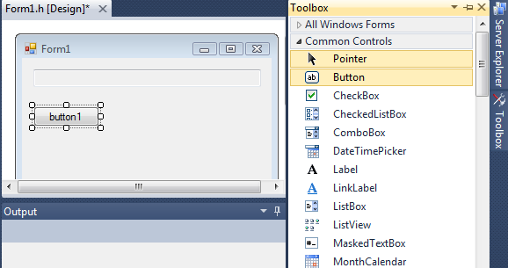
Button
Click on Toolbox again, then drag and drop a Button to the container.

Slide 42
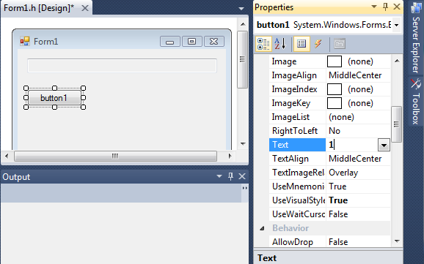
Button Text
Open the button’s property pane in the same way as shown earlier.
Click on the field next to the property “Text”, and type “1” in it, then press enter.

Slide 43
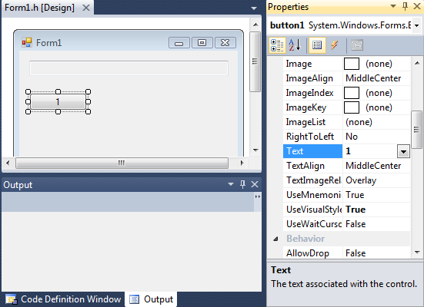
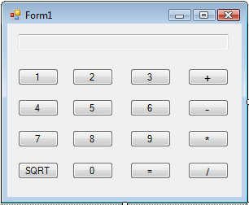
Button Text continued
This should change the text displayed on the button to “1”. Now repeat this process and create the other buttons for the calculator.
Then you should have something like this.

Slide 44
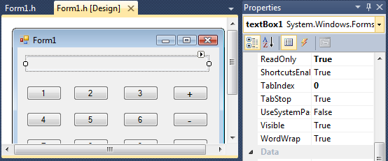
Event Handling
We’d like to display output in the TextBox. In order to do that, we need to find out the handle that refers to it. Click on the TextBox and notice that in the top combo box of the property pane, its name “textBox1” is displayed. This name is its handle. We’ll explain in a short bit.
Now double click the button “1” to automatically generate an event handler for clicking this button.

Slide 45
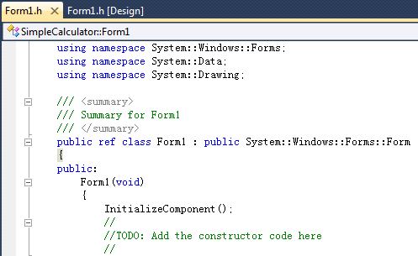
Event Handling continued
You will automatically be directed to “Form1.h”, which contains the class “Form1” extended from the “Form” class of CLR.
Ignore the initialization part and go straight down to this event handler.
The parameter “sender” is the handle to the component generating the event. Notice the “^” after the class names of “Object” and “EventArgs”. This means they are a special kind of pointers, which address CLR ref class objects. But this is of no big concern now.
Let’s add some code in this function to handle this event.

Slide 46

Event Handling continued
Write the following two lines of codes in the event handler. It simply appends the text on the button to the text in the TextBox and prints this new string in the TextBox. Remember the name of the TextBox is “textBox1”? Yes, that would be its member name in our Form class.
Now writing 10 event handlers, each for a different digit button would be tedious. We’d like to use one handler to take care of them all. We will show how to do that in the next slide.

Slide 47
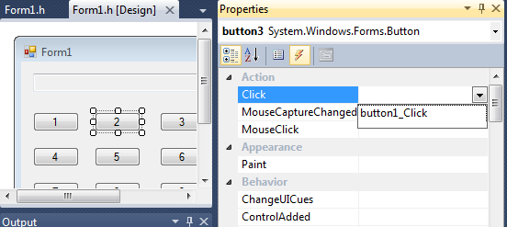
Multiple Events, One Handler
Open the property pane of Button “2”.
Click on the lightning bolt icon to switch to the event handling panel.
Open the drop down menu next to “Click”, then select “button1_Click”, which is the event handler we’ve just written.
Do the same for all other digit buttons from 3 to 0.

Slide 48
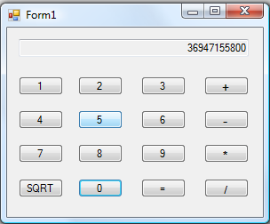
Compile and Run
Play around with it. Of course the event handler we’ve just written is a gross over-simplification of what needs to be done. However, all the knowledge essential for creating a simple calculator has already been covered.
Finish it yourself as an exercise.

